Slide 1

FI PLUGIN
BaaS Partners Feedback
March 2022

Slide 2
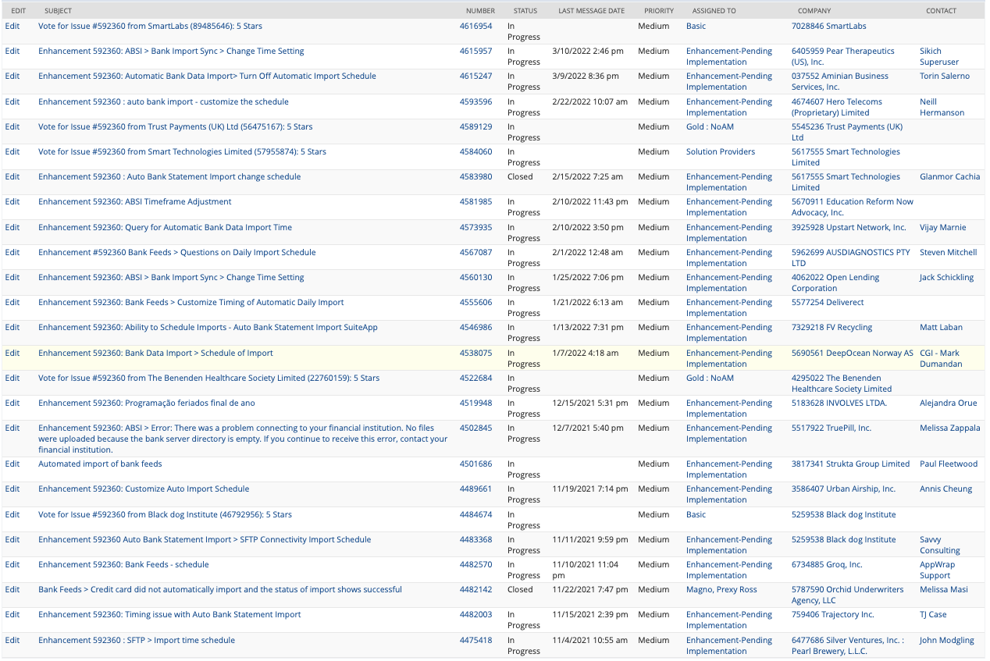
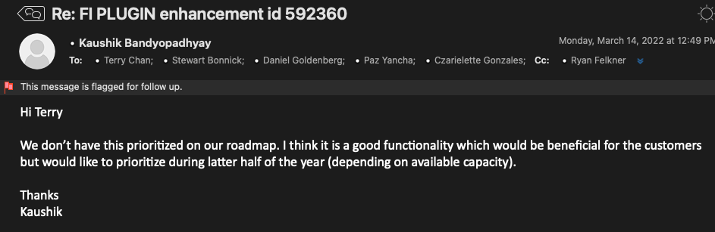
Enhancement:
592360 FI Connectivity Plugin - automated daily import schedule to be customizable
Description:
FI Connectivity Plugin - automated daily import schedule to be customizable
Attached Cases:

Slide 3

9W Feedback

Slide 4
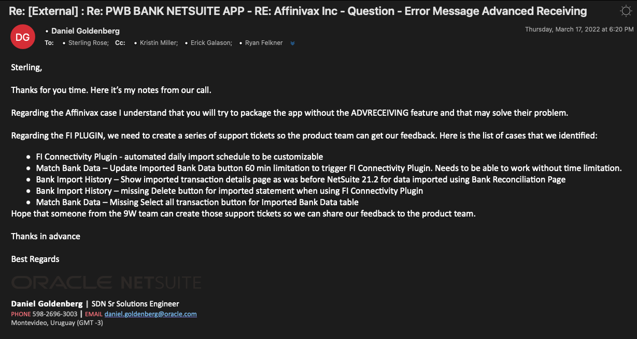

Slide 5

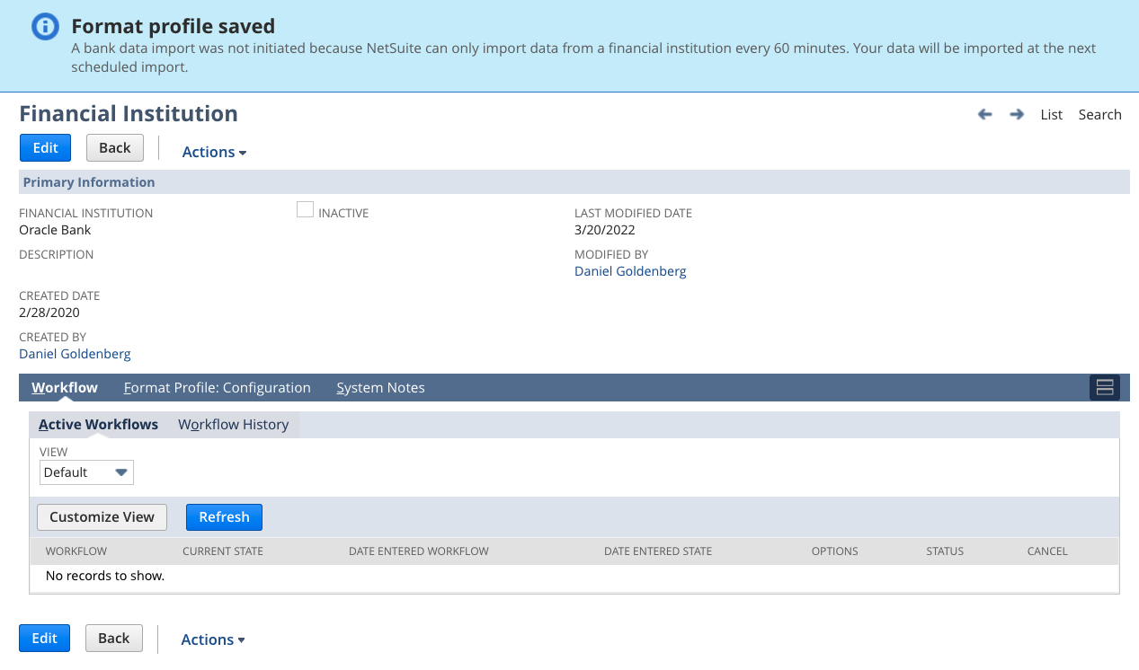
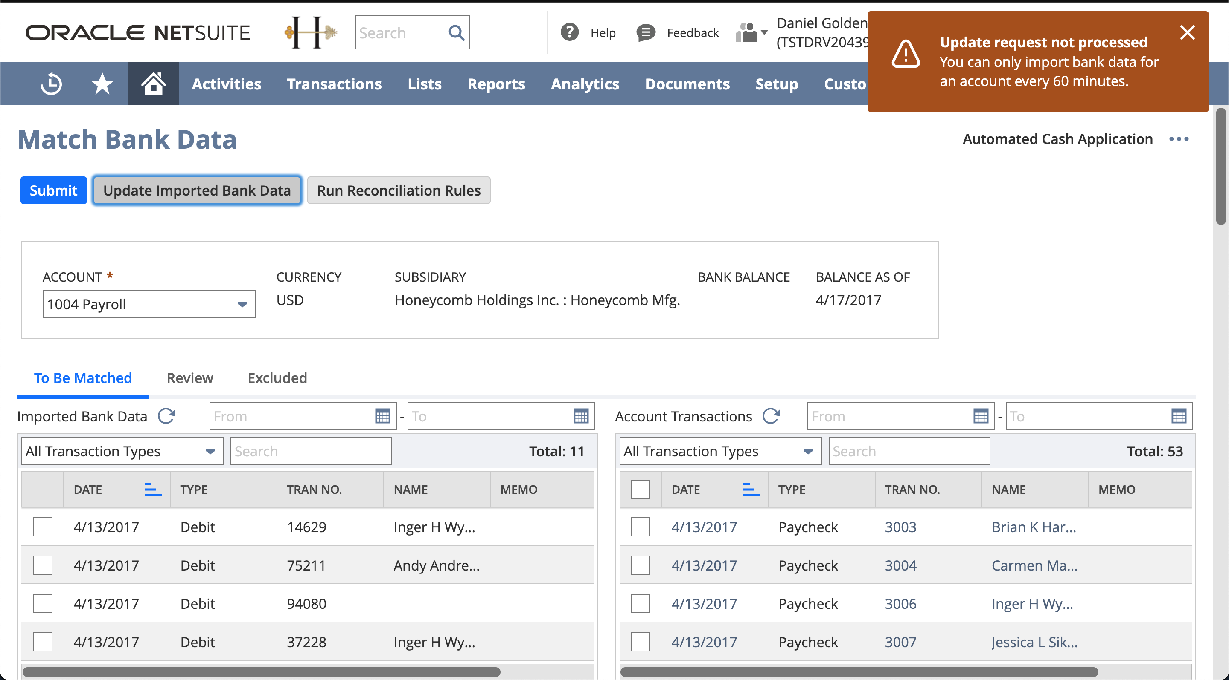
Case #: TBD
Description:
Match Bank Data – Update Imported Bank Data button 60 min limitation to trigger FI Connectivity Plugin. Needs to be able to work without time limitation.

Slide 6
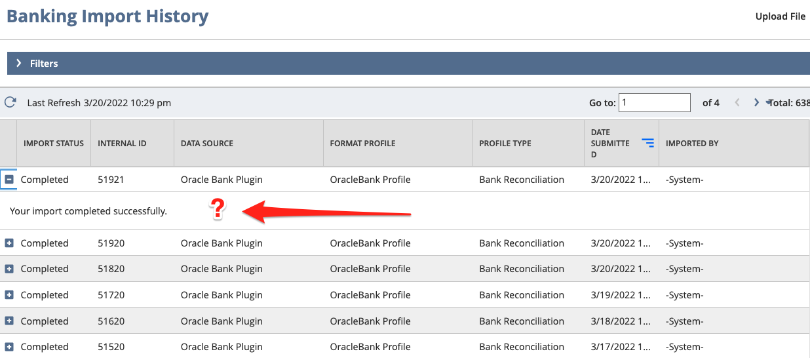
Case #: TBD
Description:
Bank Import History – Show imported transaction details page as was before NetSuite 21.2 for data imported using Bank Reconciliation Page

Slide 7
Case #: TBD
Description:
Bank Import History – missing Delete button for imported statement when using FI Connectivity Plugin

Slide 8
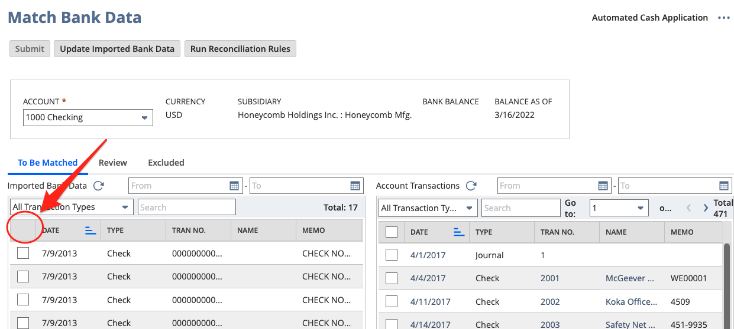
Case #: TBD
Description:
Match Bank Data – Missing Select all transaction button for Imported Bank Data table

Slide 9
FISPAN New Feedback

Slide 10
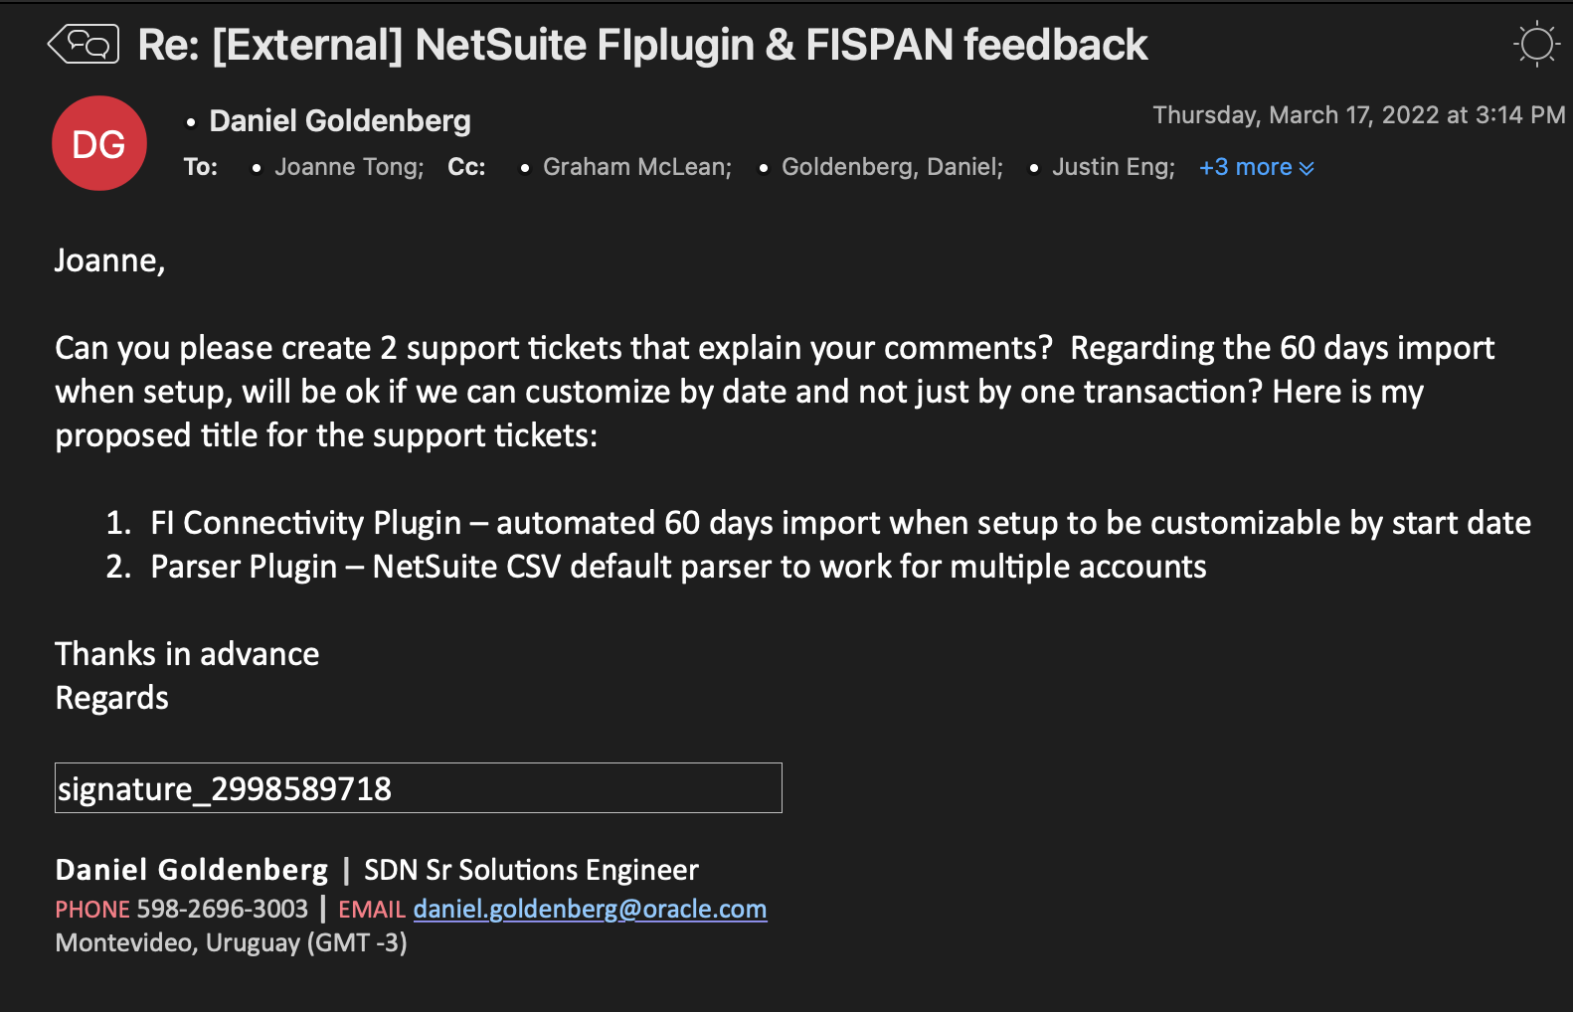

Slide 11
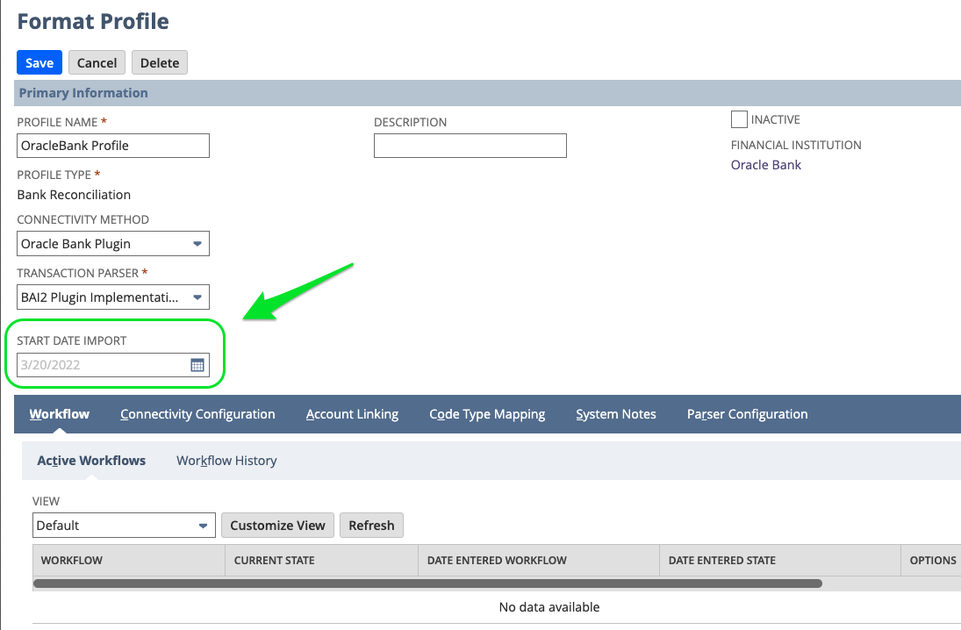
Case #: TBD
Description:
FI Connectivity Plugin – automated 60 days import when setup to be customizable by start date
Solution

Slide 12
Case #: TBD
Description:
Parser Plugin – NetSuite CSV default parser to work for multiple accounts
Workaround: Create custom parser

Slide 13
PNC Bank Feedback

Slide 14
TBD

Slide 15
BaaS Partner FI PLUGIN On Boarding material content list:
Video Tutorial
Financial Institution concept
Format profile concept
iFrame setup playbook
Account setup
Default parsers
Code Example
fi plugin example
SuiteLet iFrame
Installation Script:
Create Financial Institution
Create Format Profile
FormatProfile CustomField (Start Date Import)

Slide 16

Partner On boarding material status

